Slide 1
📊 Ecommerce Data Analysis
By Richa P | March 2025

Slide 2
📌 Project Goals
Analyze monthly sales performance
Identify best and worst performing categories and sub-categories
Understand monthly profit trends
Analyze customer segment performance
Evaluate sales-to-profit ratio

Slide 3
🧠 Tools & Dataset Used
Python (Pandas, plotly)
Jupyter Notebook
SQL
Excel
Dataset: ecommerce_data.csv

Slide 4
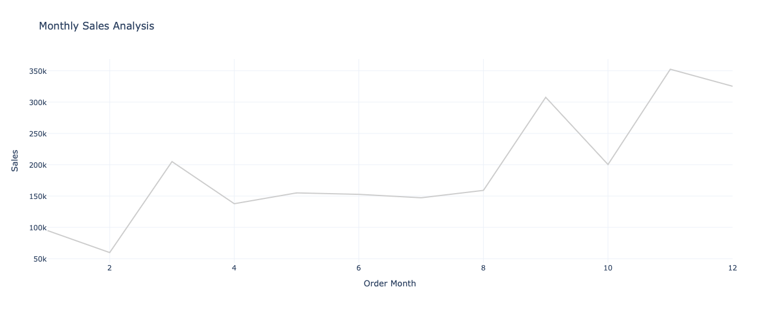
📅 Monthly Sales Trends
Sales trend across each month

Slide 5
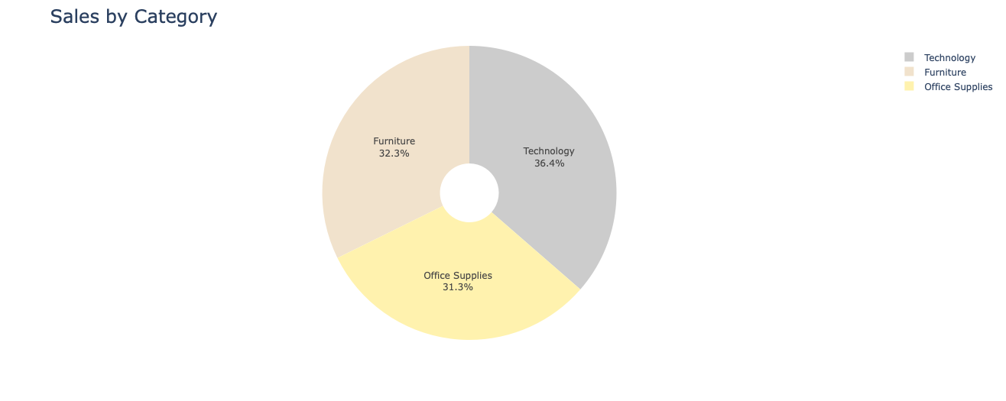
🛒 Category-wise Sales Analysis
Sales breakdown by category
Top-performing vs low-performing category
Visual: Bar chart

Slide 6
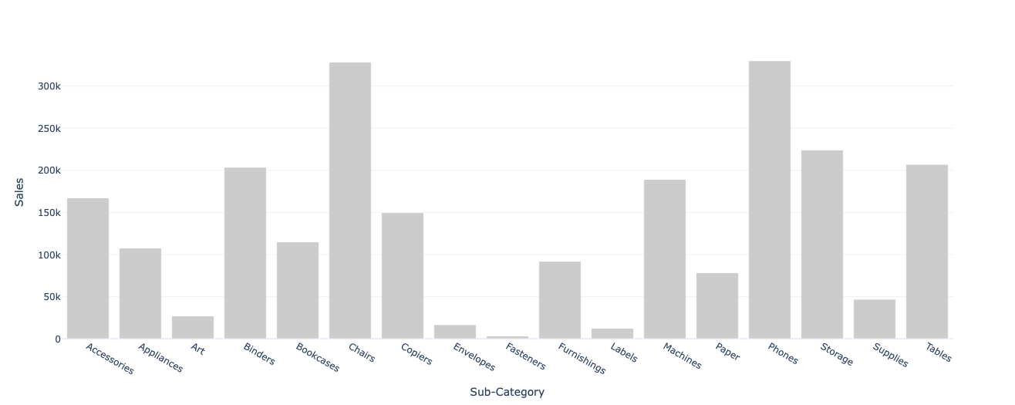
📂 Sub-category Sales Breakdown
Sales contribution from each sub-category
Visual: Pie or bar chart

Slide 7
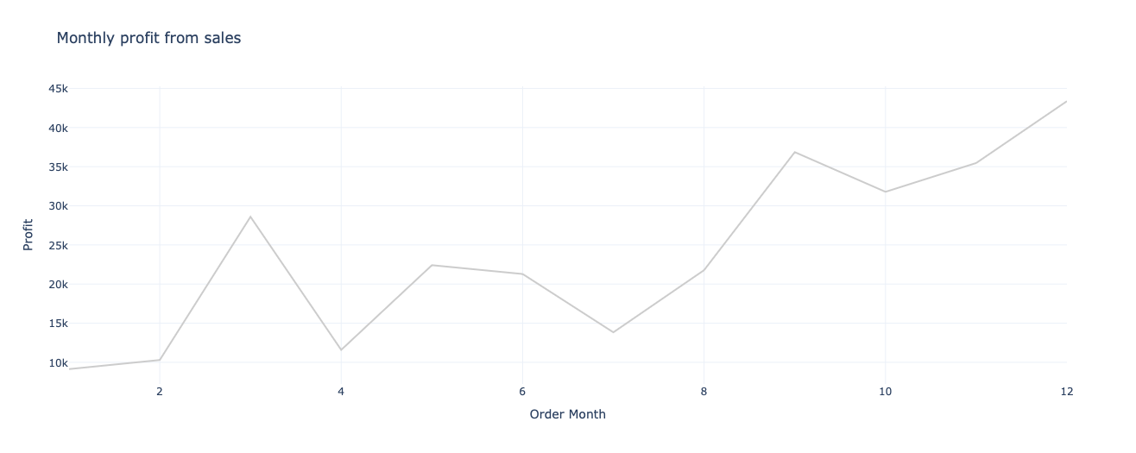
💰 Monthly Profit Analysis
Monthly profit trend
Identify highest profit month
Visual: Area or line chart

Slide 8
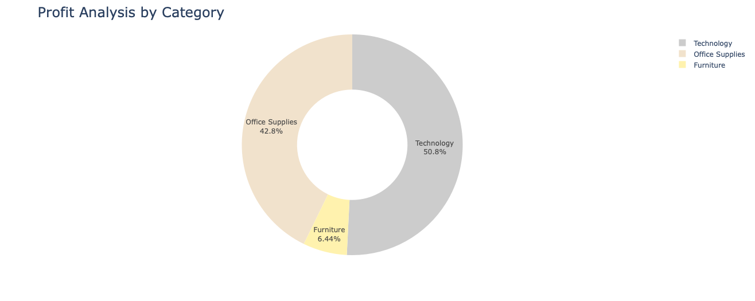
📈 Profit by Category
Detailed profit breakdown
Visual: Bar chart or heatmap

Slide 9
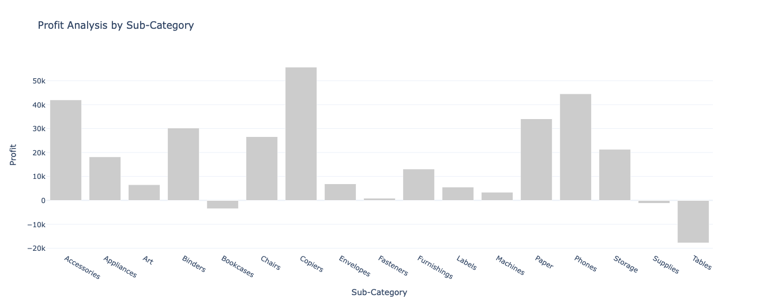
📈 Profit by Sub-category

Slide 10
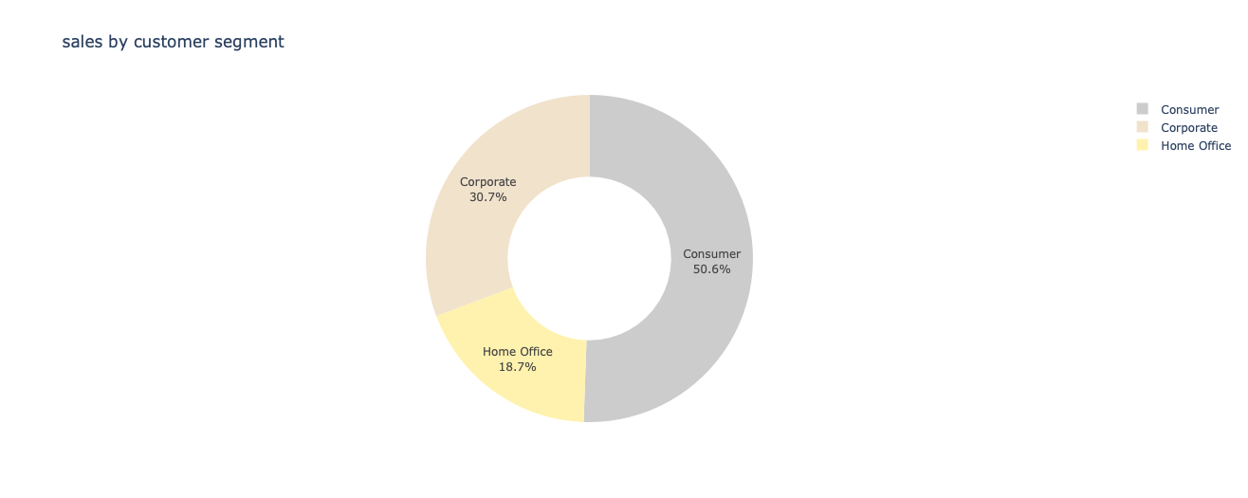
👥 Customer Segment Performance
Sales by customer segment

Slide 11
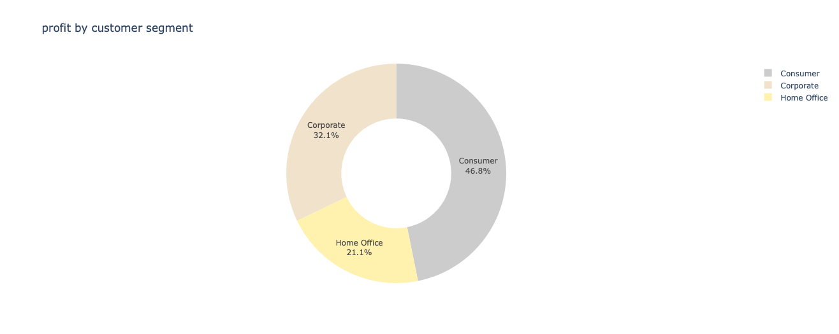
👥 Customer Segment Performance
Profit by customer segment
Compare performance across segments
Visual: Comparative chart

Slide 12
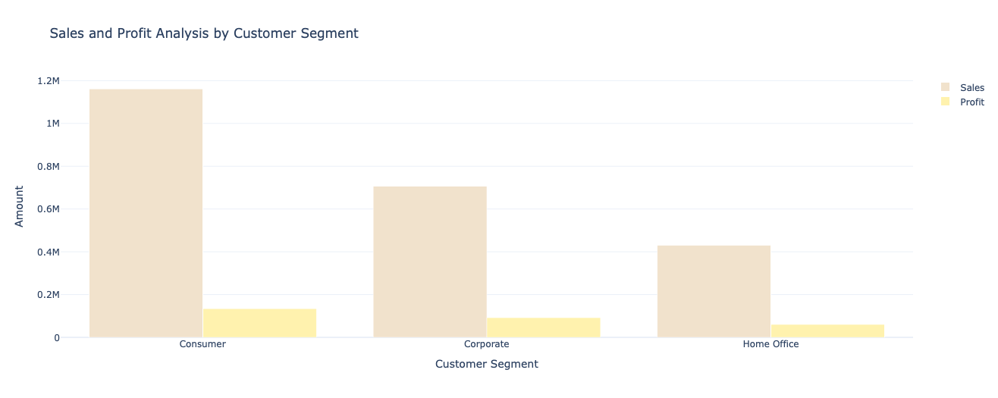
Comparative analysis of profit and sale by customer segment

Slide 13
📉 Sales to Profit Ratio Analysis
Evaluate efficiency of profit generation from sales
The findings were :
Segment | Sale to Profit Ratio
Consumer | 8.66
Corporate | 7.68
Home Office | 7.13

Slide 14
💡 Conclusion
Highest sales happen during November (Thanksgiving season since it is US data)
Least sales happen during February and increases in March(during spring break)
Category wise technology products have a bit more sale(2%more) than Office and Furniture products
People do not order readily available and immediate requirement products like envelopes more.
Fasteners are not much ordered maybe because of preferable window shopping for this category
Chairs are the most ordered products followed by phones(preferably due to the discount)
The Consumer segment requires $8.65 of sales to make $1 profit, while Home Office only needs $7.13 and corporate required $7.68
This implies Home Office is more profitable per unit of sales than the Consumer segment.

Slide 15
🙏 Q&A / Thank You
Thank you for your time!
Open to questions and feedback.

